Slide 1
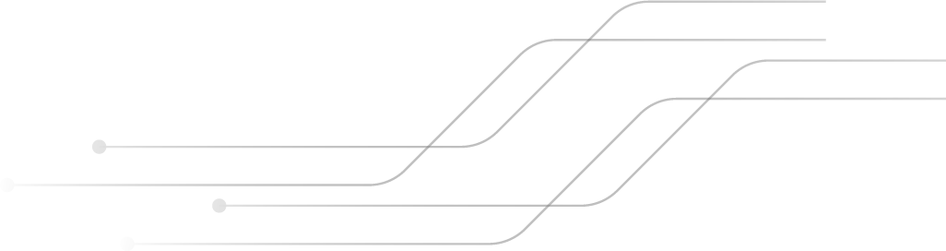


SISTEMAS DE REDES VS DISTRIBUÍDOS
Ariany Andrade e Daniel da Silva 1°C

Slide 2

INTRODUÇÃO
1
2
SISTEMA DE REDE
SISTEMA DISTRIBUÍDOS
Informações para descrever o que é um Sistema operacional de redes
Informações para descrever o que é um Sistema Operacional Distribuídos

Slide 3
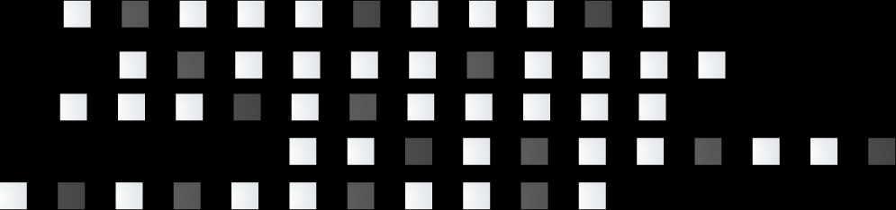
SISTEMA DE REDE
1

Slide 4
SISTEMA DE REDE
1
Um Sistema Operacional de Redes é um conjunto de módulos que amplíam os sistemas operacionais, complementando-os com um conjunto de funções básicas, e de uso geral, que tornam transparente o uso de recursos compartilhados da rede.

Slide 5
TÓPICOS DO SISTEMA DE REDE
O objetivo principal do Sistema de Rede é fornecer os serviços locais ao cliente remoto.
Venus has a beautiful name and is the second planet from the Sun
No sistema de rede, a comunicação ocorre com base em arquivos.

Slide 6
PREDICTED RESULTS
20,500
Jupiter is the biggest planet in the Solar System
150
Despite being red, Mars is a cold place
VENUS
It has a beautiful name, but it’s terribly hot
If you want to learn how to modify this graph, click here

Slide 7

PROJECT GOALS
VENUS
90%
It has a beautiful name, but it’s terribly hot
JUPITER
It’s the biggest planet in the Solar System
70%
MARS
30%
Despite being red, Mars is a cold place

Slide 8
FUTURE TASKS
 | DESCRIPTION | START DATE
TASK 1 | Despite being red, Mars is a cold place | 06/01
TASK 2 | Jupiter is the biggest planet of them all | 08/12
TASK 3 | Venus is the second planet from the Sun | 11/15

Slide 9
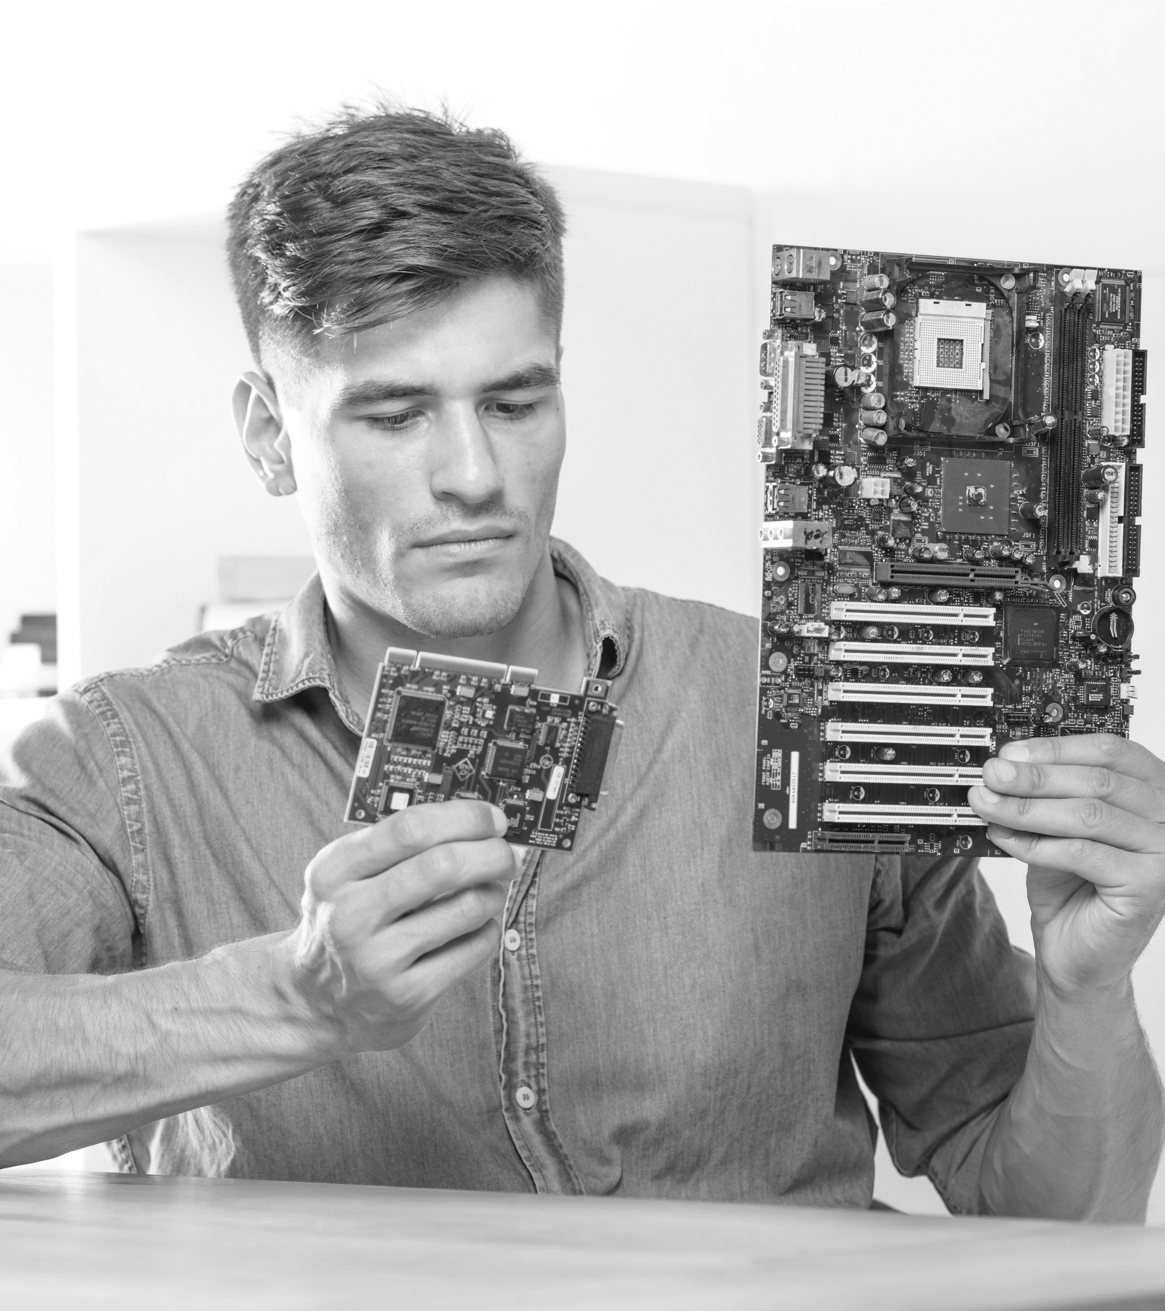
A PICTURE ALWAYS REINFORCES THE CONCEPT
Images reveal large amounts of data, so remember: use an image instead of a long text. Your audience will appreciate it

Slide 10
THANKS!
Does anyone have any questions? addyouremail@freepik.com +91 620 421 838 yourcompany.com
Please keep this slide for attribution

Slide 11
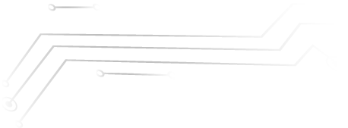


ALTERNATIVE RESOURCES
Here’s an assortment of alternative resources whose style fits the one of this template:
PHOTOS:
Engineer putting the ram memory module in motherboard
Male it technician looking at pc motherboard
Computer socket; adapter and audio ports of computer
VECTORS:
Bright green technology background
Neon fingerprint background concept

Slide 12
RESOURCES
Did you like the resources on this template? Get them for free at our other websites:
PHOTOS:
Close-up of it male technician repairing the computer mainboard
Young male it technician holding two circuits board
VECTORS:
Green technology background
Bright green technology background
Gradient green technology background
Gradient bright green technology background
ICONS:
Programming Icon Pack

